Slide 1

SQL Case study
Challenge 3 - Customer Insights
From- Steel Data and Matthew Steel
Presentation by – T.A Siva Bhavani

Slide 2
Introduction
Assuming as a Customer Insights Analyst for 'The General Store’ I analysed the following tables given to find out crucial information about the customers to provide to insights to the marketing team.
TABLES Given :-
1)Customers
2) Orders
3) Baskets
4)Products
5)Country

Slide 3
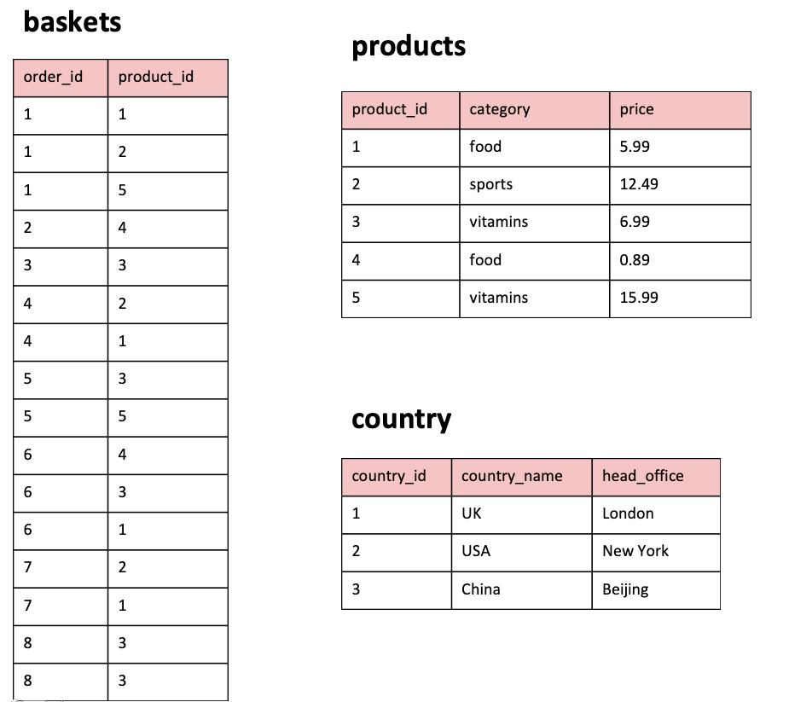
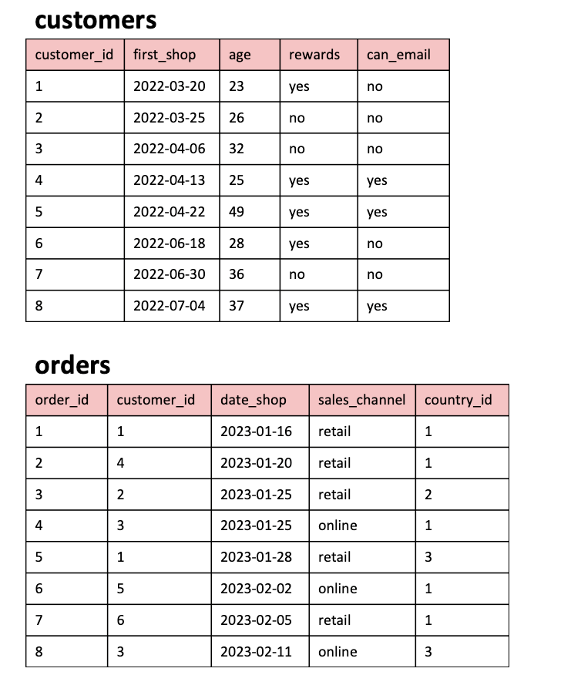
TABLES

Slide 4
Requirement
1. What are the names of all the countries in the country table? 2. What is the total number of customers in the customers table? 3. What is the average age of customers who can receive marketing emails (can email is set to 'yes')? 4. How many orders were made by customers aged 30 or older? 5. What is the total revenue generated by each product category? 6. What is the average price of products in the 'food' category? 7. How many orders were made in each sales channel (sales channel column) in the orders table? 8.What is the date of the latest order made by a customer who can receive marketing emails? 9. What is the name of the country with the highest number of orders? 10. What is the average age of customers who made orders in the 'vitamins' product category?

Slide 5
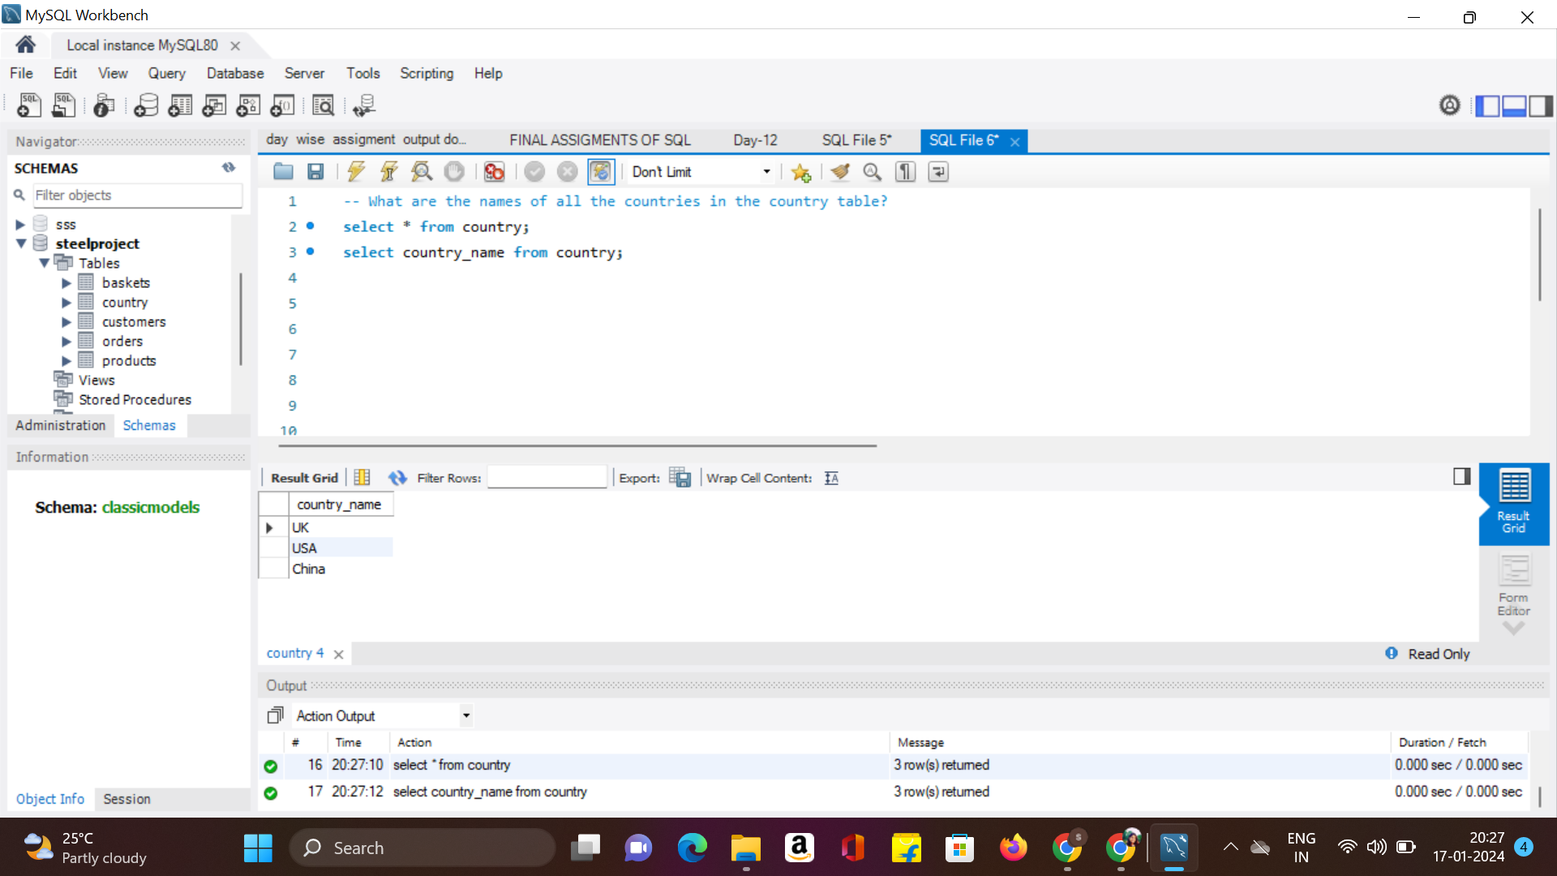
1. What are the names of all the countries in the country table?

Slide 6
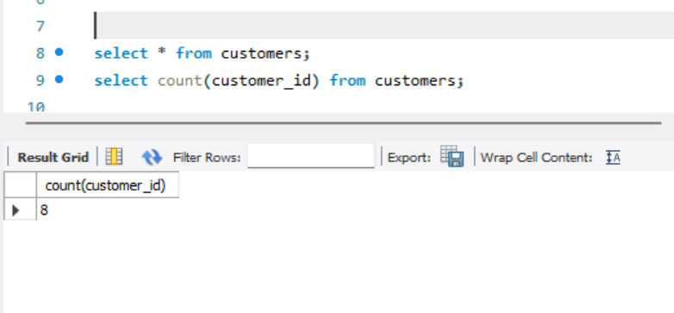
2. What is the total number of customers in the customers table?

Slide 7
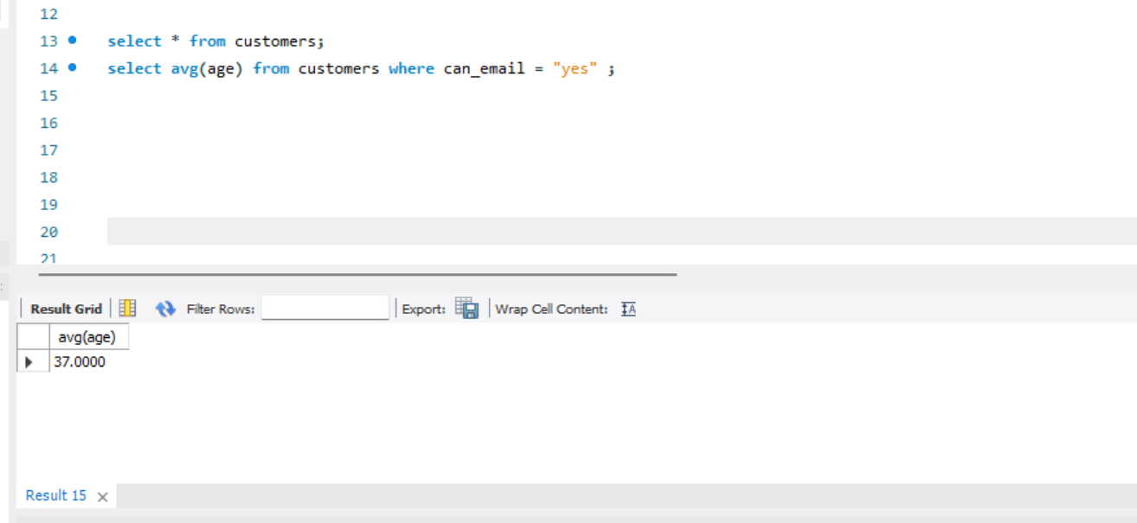
3. What is the average age of customers who can receive marketing emails (can email is set to 'yes')?

Slide 8
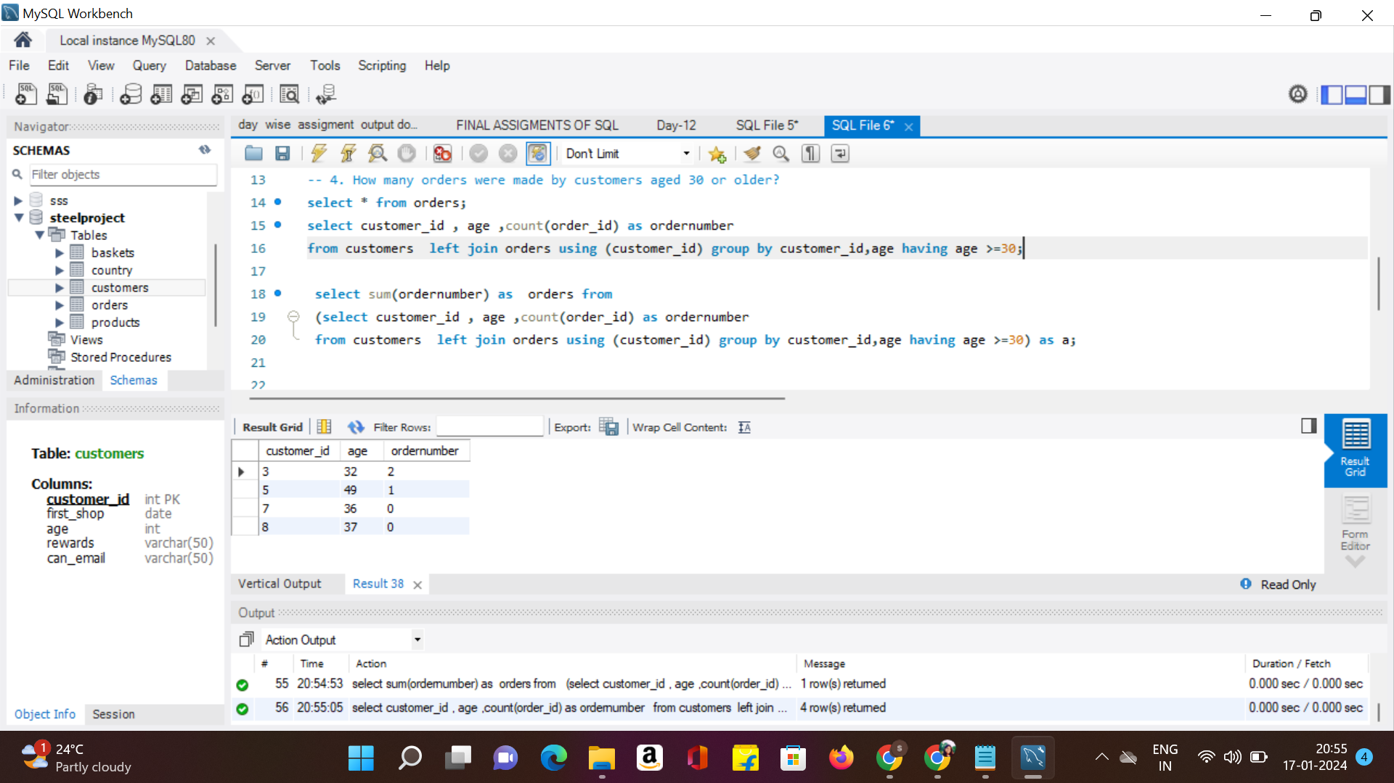
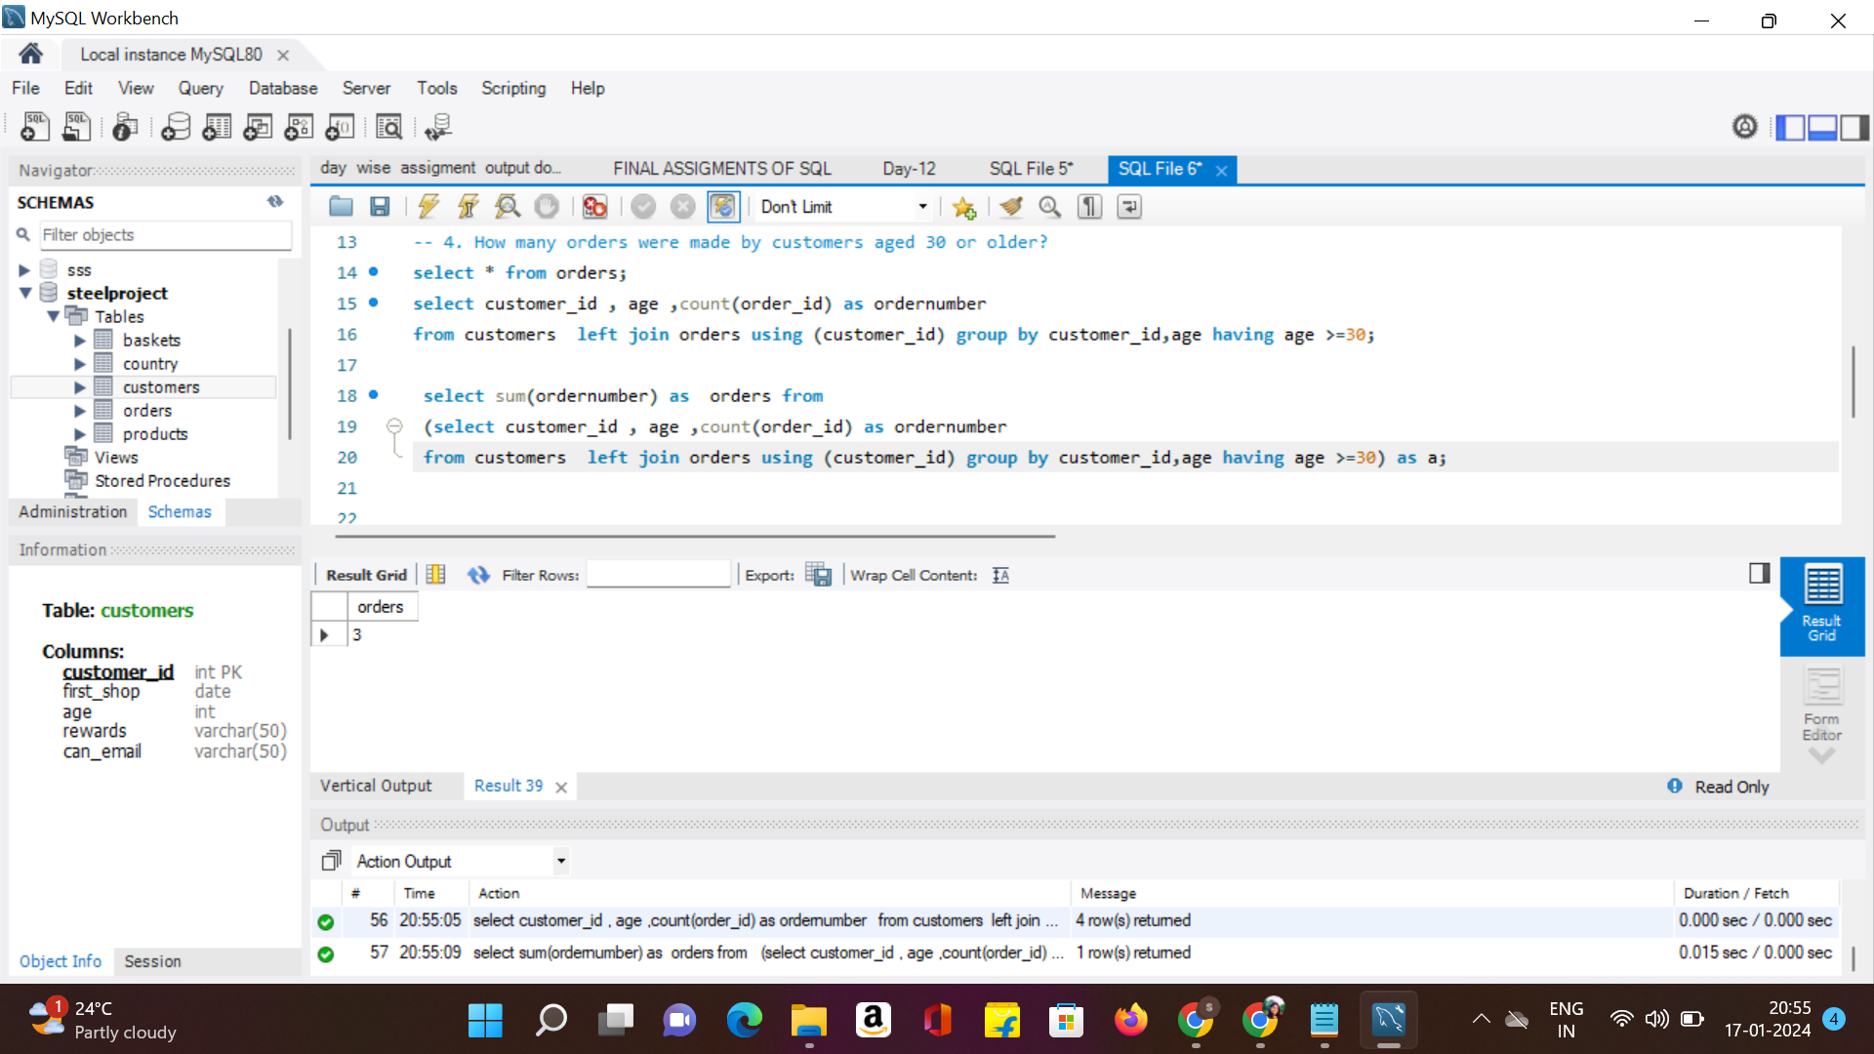
4. How many orders were made by customers aged 30 or older?

Slide 9
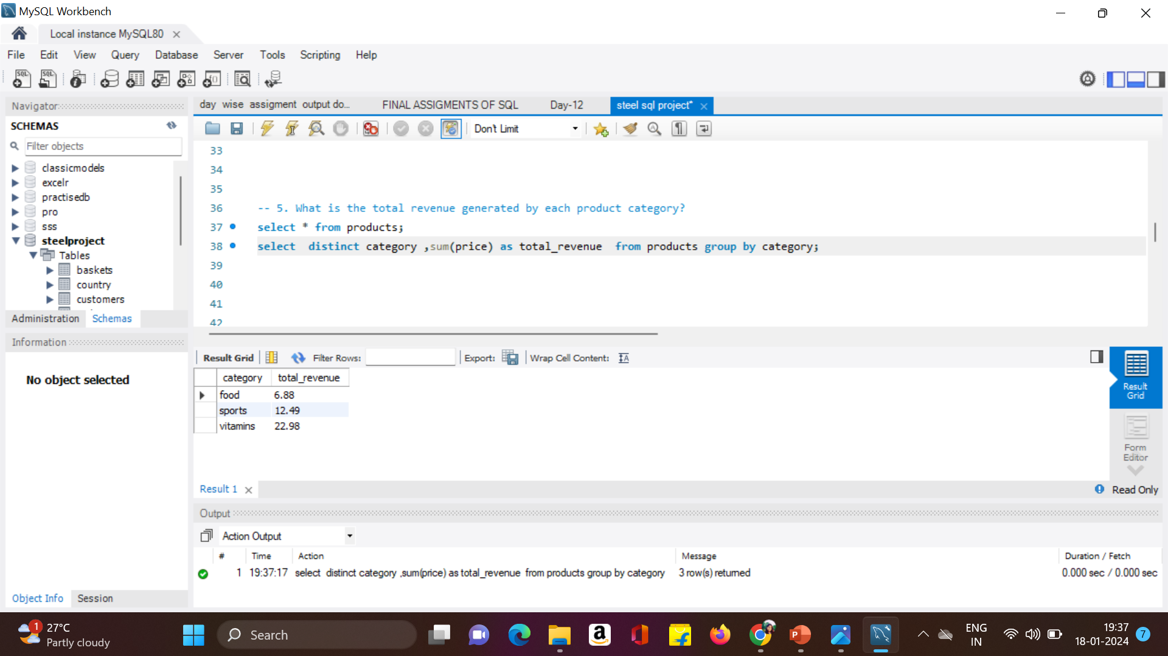
5. What is the total revenue generated by each product category?

Slide 10
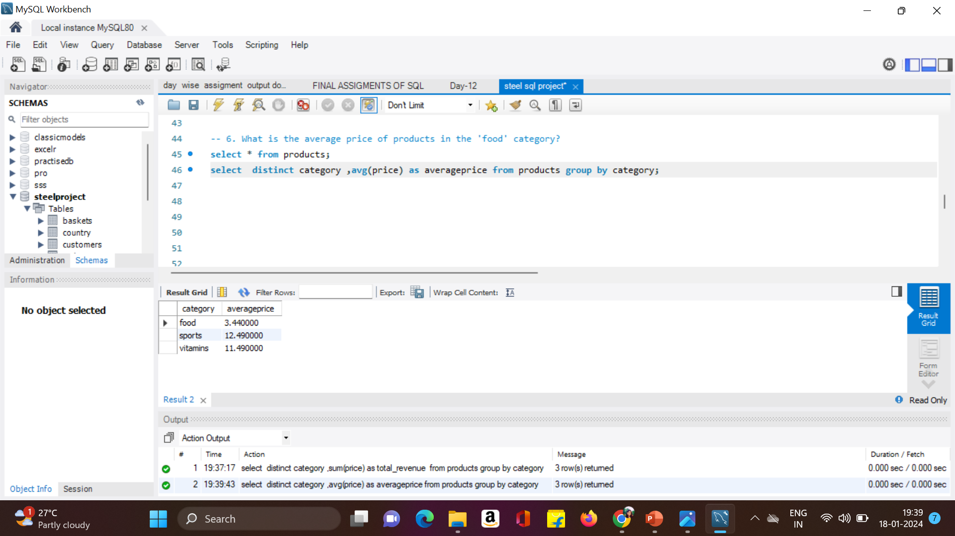
6. What is the average price of products in the 'food' category?

Slide 11
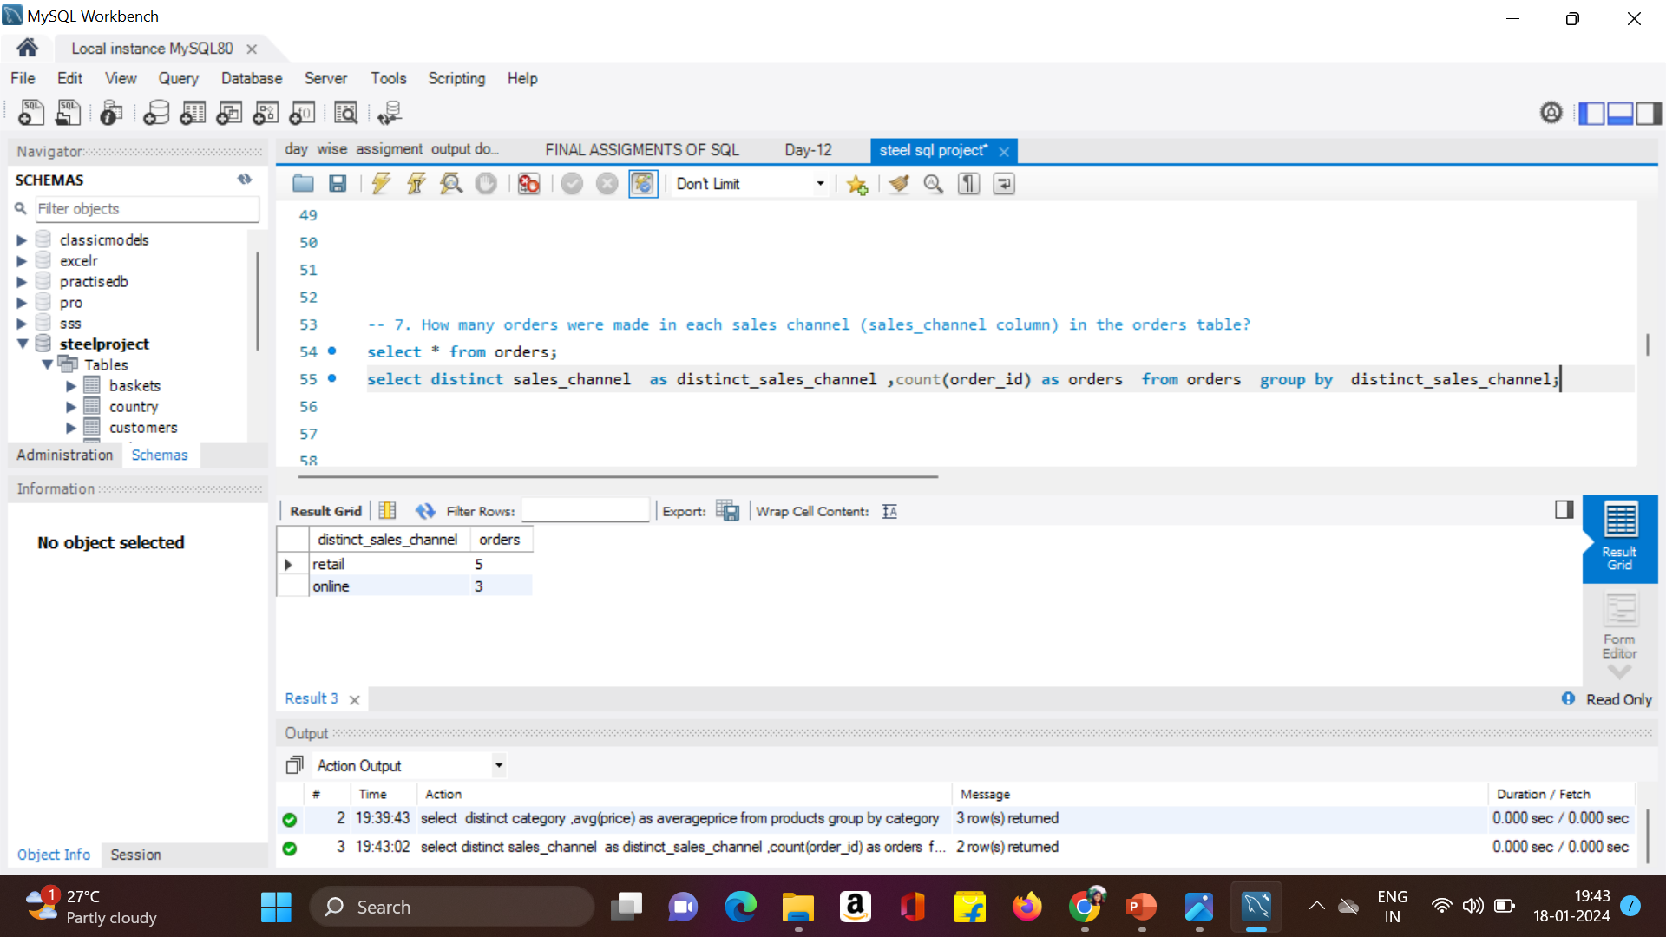
7. How many orders were made in each sales channel (sales channel column) in the orders table?

Slide 12
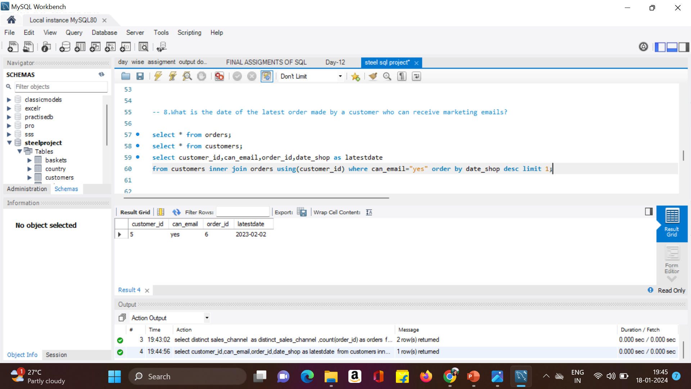
8.What is the date of the latest order made by a customer who can receive marketing emails?

Slide 13

9. What is the name of the country with the highest number of orders?

Slide 14
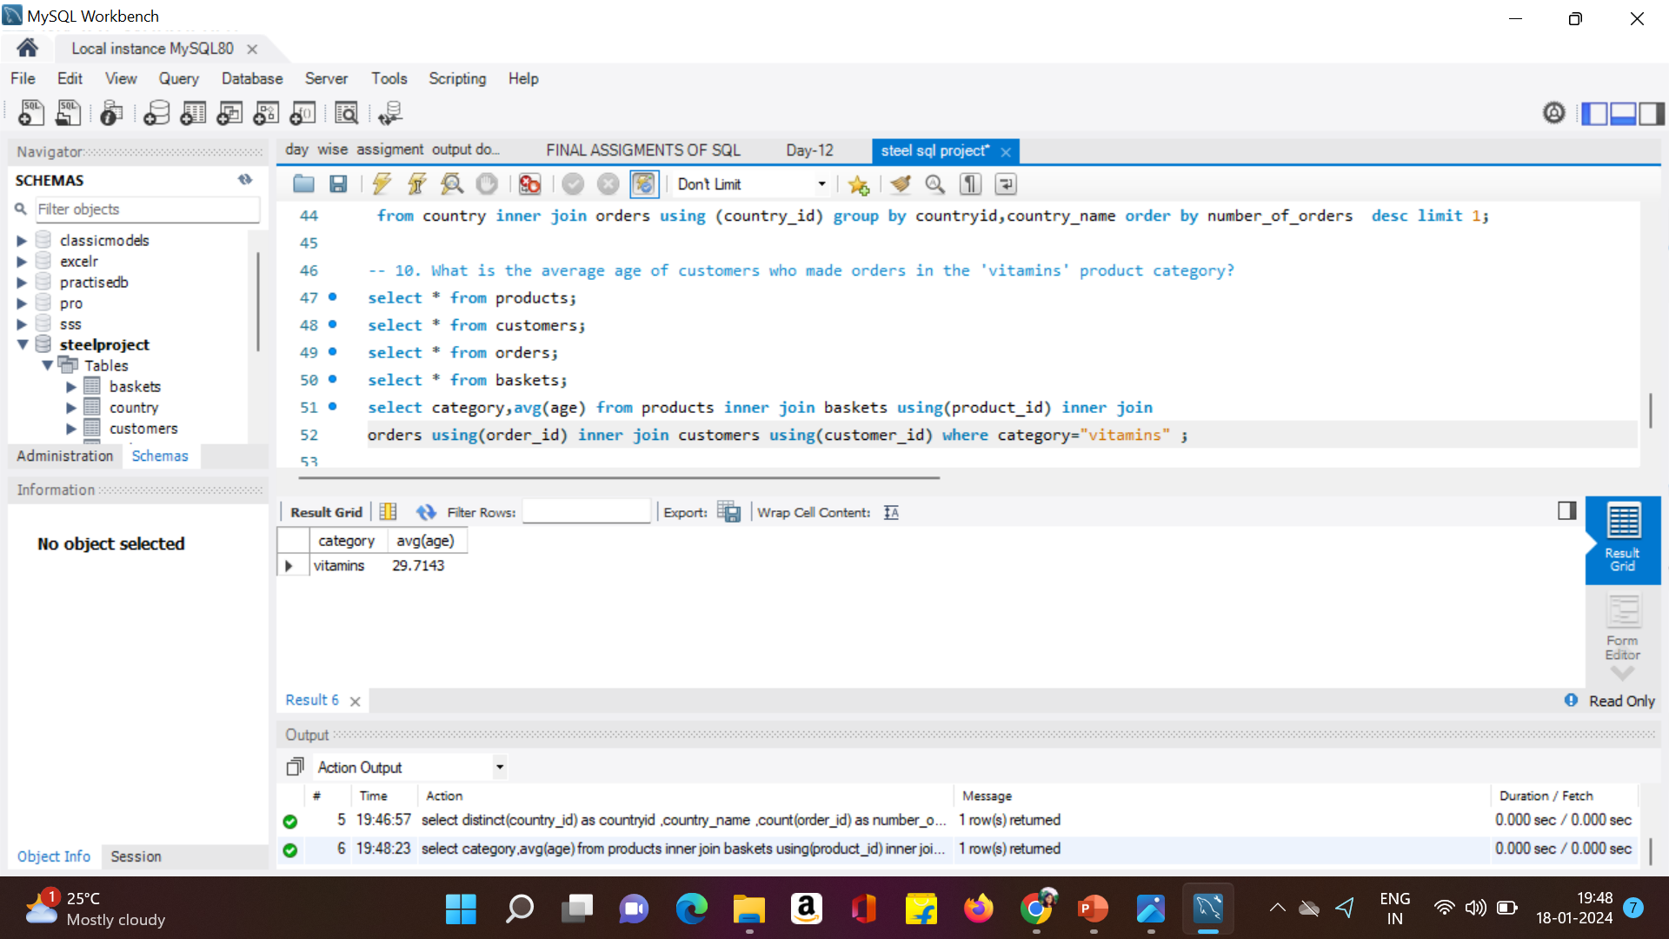
10. What is the average age of customers who made orders in the 'vitamins' product category?

Slide 15


This Photo by Unknown Author is licensed under CC BY-SA

